Slide 1

Session 3.2: Project Methodology and Project Start Up
Dr Andre Samuel
andre.samuel@sam.edu.tt

Slide 2
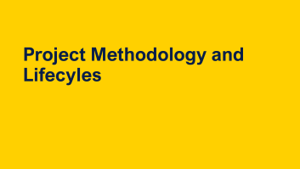
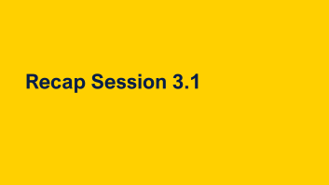

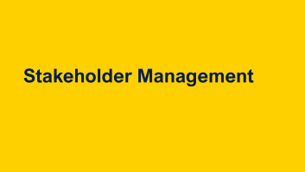
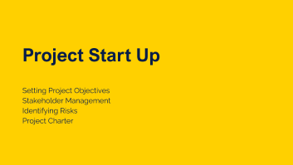
Learning Outcomes

Slide 3
Recap Session 3.1

Slide 4
PM Interpersonal Skills PMI (2021)
Leadership
Team building
Motivation
Communication
Influencing
Decision making
Political and cultural awareness
Negotiation
Trust building
Conflict management
Coaching

Slide 5
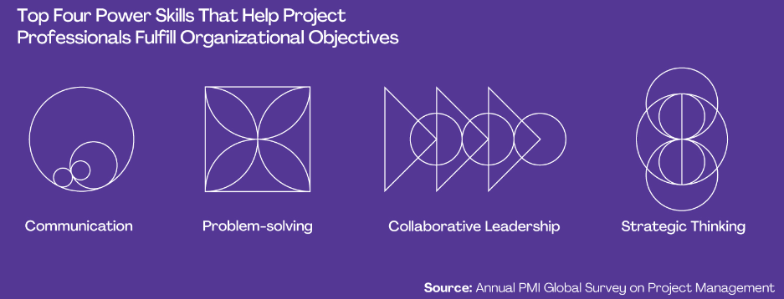
What Are Power Skills?
PMI (2022) defines power skills as abilities and behaviors that facilitate working with others and help project professionals to succeed in the workplace.
Some individuals and other organizations also refer to them as “soft skills” or “interpersonal skills.”
PMI 2022

Slide 6
For Part 1.b- Reflection before and after module
You can adapt and use the template
Project Management Skills | Did you have this skill (before the module)? Yes No | If YES score 1 - 5 (with 1 being less skilled and 5 being most skilled) How can you evidence this skill? | Did you improve in this skill by the end of the module? | End of module score 1 - 5 (with 1 being less skilled and 5 being most skilled)

Slide 7
Stages of Team development
Tuckman (1965) says that teams go through 4 phases: forming; storming; norming and performing. He added adjourning later in 1975.
It is important to be aware of these phases in your project and manage them effectively – project progress depends on it
3
2
Norming
Storming
4
1
Performing
Forming

Slide 8
Project Governance and Internal Project Team (adapted from Maylor, 2017, pp. 62)
PROGRAMME MANAGEMENT
 | PROJECT BOARD/PROJECT STEERING GROUP
USER REPRESENTATIVE | PROJECT SPONSOR | SUPPLIER REPRESENTATIVE
Senior User | Executive/Senior responsible Owner | Senior Supplier
TECHNICAL ADVISORY GROUP
CHANGE BOARD Delegated authority Technical capability
PROJECT MANAGER
PROJECT MANAGEMENT OFFICE Admin support Technical support Configuration management
TEAM MANAGER
TEAM MANAGER
TEAM MEMBERS
TEAM MEMBERS
Notes:
As a Project Manager you are working within the organisational structure. You will need to work with the governance in place, e.g. the Project Board/Steering Group and also need to lead your project team

Slide 9
Belbin Team Roles
Types of Roles | Roles | Key features
Action Oriented Roles | Shaper Implementer Completer/Finisher | Challenges the team to improve Puts ideas into action Ensures thorough, timely completion
People Oriented Roles | Coordinator Team Worker Resource Investigator | Acts as chairperson Encourages cooperation Explores outside opportunities
Thought Oriented Roles | Plant Monitor-Evaluator Specialist | Presents new ideas and approaches Analyzes the options Provides specialized skill
What was the outcome of the Belbin Team Roles Questionnaire?

Slide 10
Assignment Guide Task 1
Available on Samuel Learning.org

Slide 11
Project Methodology and Lifecyles

Slide 12
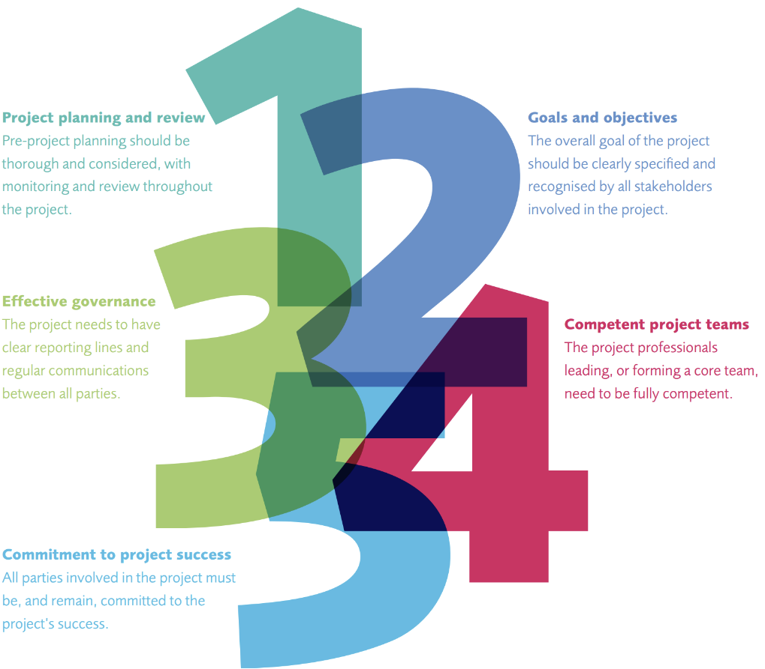
Why do we need a project methodology?
APM’s (2015) Project success research discovered 5 most key factors that make projects successful.
3 of them relate to project management method:
Project planning and review
Goals and objectives
Effective governance
The other 2 relate to skills and commitment
Notes:
Full list of 12:
1. Project planning and review
Pre-project planning should be thorough and considered, with monitoring and review throughout the project.
2. Goals and objectives
The overall goal of the project should be clearly specified and recognised by all stakeholders involved in the project.
3. Effective governance
The project needs to have clear reporting lines and regular communications between all parties.
4. Competent project teams
The project professionals leading, or forming a core team, need to be fully competent.
5. Commitment to success
All parties involved in the project must be, and remain, committed to the project’s success.
Capable sponsors Sponsors play an active role in the life cycle of the project; they assume ultimate responsibility and accountability for the project outcomes.5 Secure funding The project has a secure funding base; contingency funding is recognised from the start and tight control of budgets is in place to ensure maximum value is realised.
Supportive organisations The environment in which the project operates is project-friendly; the organisation provides support and resourcing for project activity (including financing) and access to stakeholders.
End users and operators End users or operators are engaged in the design of the project; the project team engages with users, who are able to take on what the project has produced effectively and efficiently.
Aligned supply chain All direct and indirect suppliers are aware of project needs, schedules and quality standards. Higher and lower tiers of supply chains are coordinated.
Proven methods and tools Good practice project management tools, methods and techniques are applied in a way which maintains an effective balance between flexibility and robustness.
Appropriate standards Quality standards are actively used to drive quality of outputs. Adherence to other standards is regularly monitored in order to ensure delivery is to best practice levels

Slide 13
Why do we need a Project Methodology?
“There’s method to his madness”
Shakespeare-Hamlet
Concepts and Structure
Common methods and rules
Standardize Delivery
Provide a Framework for management
Procedure and steps

Slide 14
Axelos PRINCE 2
Methodology

Slide 15
PRINCE 2
PRojects IN Controlled Environments
UK Gov standard
PRINCE – 1989 PRINCE 2 – 1996:
Focus on business justification
Defined organization structure for the project management team
Product-based planning approach
Emphasis on dividing the project into manageable and controllable stages
Flexibility that can be applied at a level appropriate to the project.

Slide 16
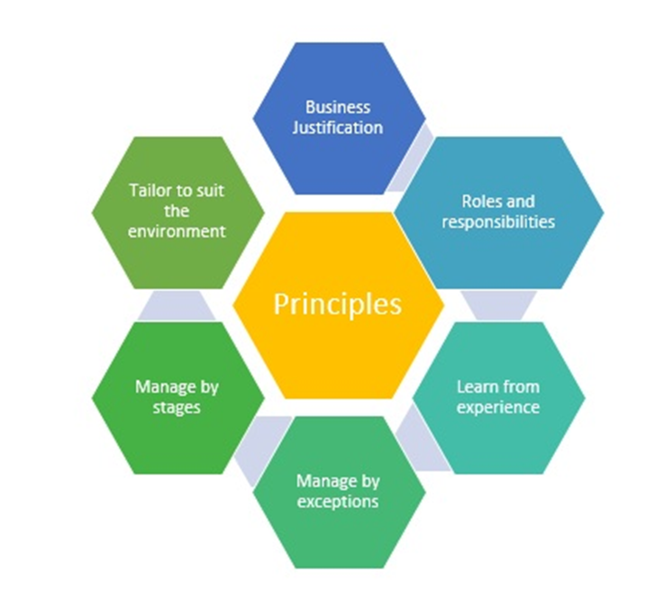
PRINCE 2 Principles
The principles provide a framework of good practice for those people involved in a project
Ensuring that the method is not applied in an overly prescriptive way
But applied in a way sufficient to contribute to the success of the project
So what are these principles?

Slide 17
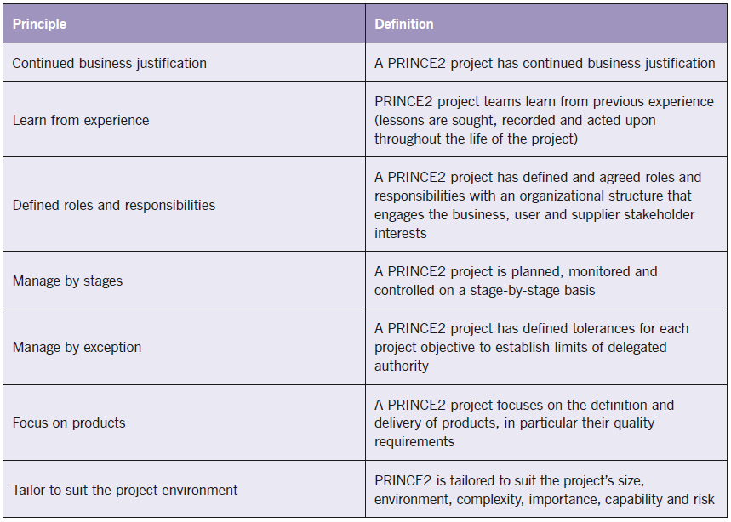
PRINCE 2 Principles
Murray (2011)

Slide 18
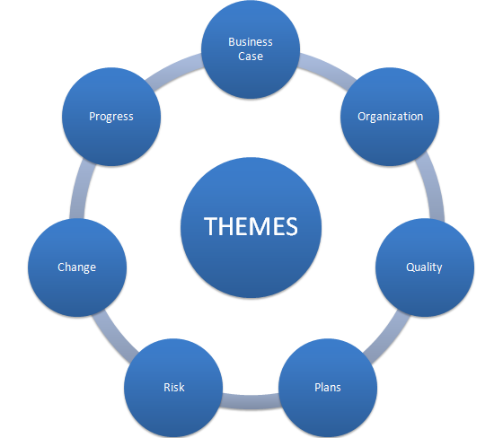
PRINCE 2 Themes
The PRINCE2 themes are those aspects of project management that need to be addressed continually throughout the project lifecycle
They provide guidance on how the process should be performed.

Slide 19
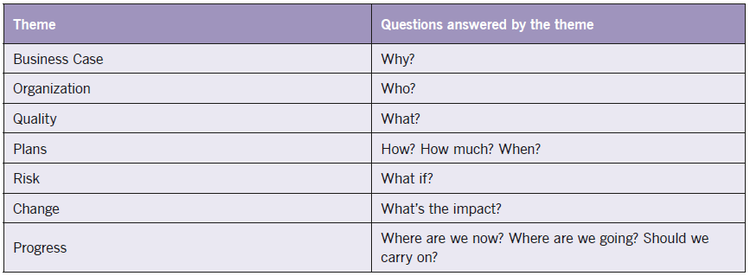
PRINCE 2 Themes

Slide 20
Prince 2 - 7 Processes
PRINCE2 provides a process model for managing a project.
This consists of a set of activities that are required to:
Direct
Manage and
Deliver a project.
An organised and controlled start, i.e. organise and plan before leaping in.
An organised and controlled middle, i.e. keeping projects organised and controlled.
An organised and controlled end, i.e. when you've got what you want and the project has finished, tidy up the loose ends

Slide 21
Prince 2 - 7 Processes
Starting up a project
Directing a project
Initiating a project
Controlling a stage
Managing product delivery
Managing a stage boundary
Closing a project
Pre-project
Initiation stage
Subsequent delivery stage(s)
Final delivery stage
Directing
Managing
Delivering
Directing a Project
Starting up a Project
SB
SB
Closing a Project
Initiating a Project
Controlling a Stage
Controlling a Stage
Managing Product Delivery
Managing Product Delivery
Axelos’s (2017)
SB = Managing a Stage Boundary
Notes:
Royce’s original stages: System requirements, Software Requirements, Analysis, Program Design, Coding, Testing, Operations

Slide 22
Starting up a Project: Covers the pre-project activities required to commission the project ‘Do we have a viable and worthwhile project?’
Directing a Project: Describes the Project Board’s activities in exercising overall project control.
Initiating a Project: Describes the activities the Project Manager must lead in order to establish the project on a sound foundation

Slide 23
Managing a Stage Boundary: Describes the activities the Project Manager must undertake to provide the Project Board with sufficient information to enable it to review the success of the current stage, approve the next Stage Plan
Controlling a Stage: Describes how the Project Manager manages the project execution/delivery activity during a stage, and reports progress and exceptions to the Project Board

Slide 24
Managing Product Delivery: Addresses the Team Manager’s role in supervising the detailed work of creating the project’s products
Closing a Project: Describes the closure activity towards the end of the final stage of the project

Slide 25
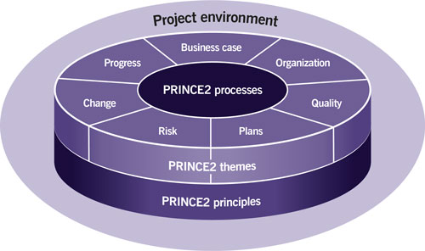

PRINCE 2- summary
Axelos - What is PRINCE2®?

Slide 26
Activity- Why use a Project Methodology?
Ready-
“If you DO NOT use a methodology, what would be the results?
Think of ONE WORD
Post in the Chat

Slide 27
Project Lifecycle
Approaches to Development

Slide 28
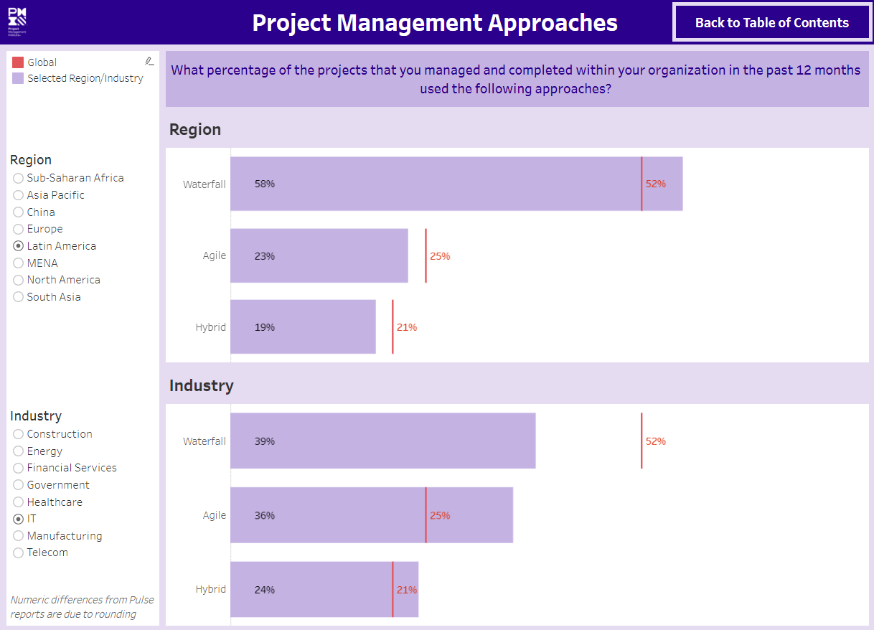
Pulse of the Profession by PMI

Slide 29
Waterfall method (Royce, 1970)
Requirements
Some with roots in information technology development, e.g.
Waterfall method (originally for software developed by Royce (1970)
Design
Implementation
Verification
Maintenance
Notes:
Royce’s original stages: System requirements, Software Requirements, Analysis, Program Design, Coding, Testing, Operations

Slide 30
Waterfall- Linear methods have been criticised
Too slow, not dynamic
Not all requirements known at the beginning
Too rigid
Need to adapt to change
Indeed in software development, Rapid Applications Development (prototyping) was adopted.
Agile Project Management took over.
SCRUM is one particular development of agile project management

Slide 31
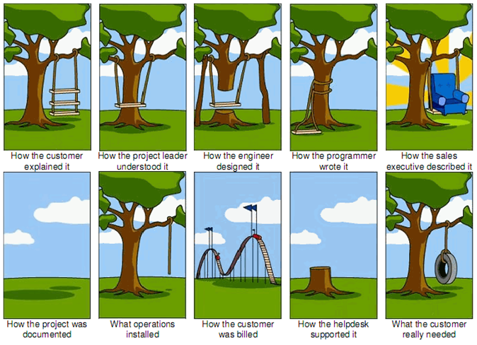
Why Agile?

Slide 32
Agile Project Management
Agile project management is an approach based on:
delivering requirements iteratively and
incrementally throughout the project life cycle.
At the core of agile is the requirement to exhibit central values and behaviours of
trust
Flexibility
empowerment and collaboration.

Slide 33
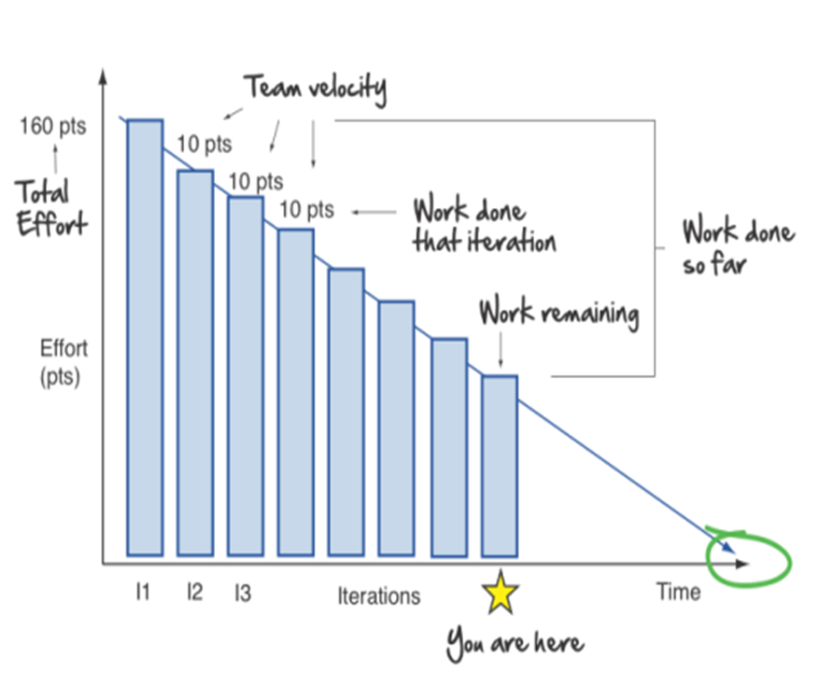
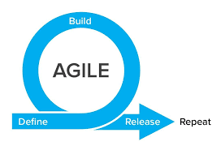
Characteristics of Agile
Agile starts work with a rough idea and as the project progresses clarifies the requirements
Delivers work in short bursts (or sprints) of anything up to a few weeks.
These are repeated to refine the working deliverable until it meets the client's requirements.
Collaborative relationships are established between stakeholders and the team members delivering the work
Sprint 1
Sprint 2
Sprint 3
Product Burndown

Slide 34
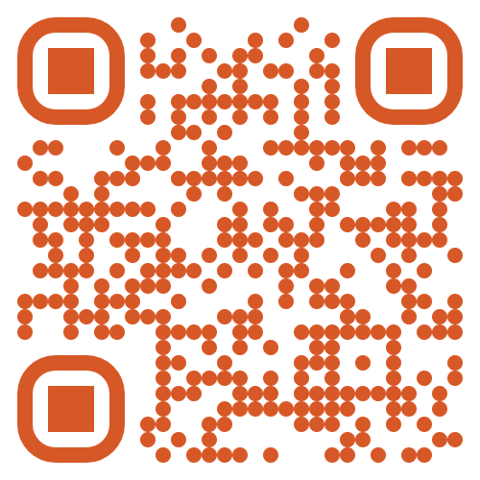
Activity- Agile Word Cloud
When you hear the term “Agile Methodology”, what words come to mind?
Go to: https://www.menti.com/d7r32t81pe
Give 3 words that come to mind

Slide 35
Agile projects need documentation, reviews and processes just as traditional projects do to meet requirements, manage costs and schedules, deliver benefits and avoid scope creep;
Agile does not expect to fully understand the requirements before work can begin.
Instead it emphasises the importance of delivering a working product as something tangible for the client that can then be refined until it fulfils the client's needs.
The key measure of project progress is this series of working deliverables.

Slide 36
Principles of Agile
Customer collaboration over contract negotiation
Individuals and interaction over processes and tools
Responding to change over following a structured plan
Prototyping/working solutions over comprehensive documentation

Slide 37
Agile Benefits
Reduce Waste
Focus on Customer Needs
Faster detection of Issues
Increased Flexibility
Agile Benefits To Project Management
Increased Adaptability
Faster Turnaround

Slide 38
Implication of Agile to Project Management
Project Management Function | Implication
Planning | Less formal, based on sprints
Scope | Collaborative and interactive approach to requirements as they are not fully known. Change is welcomed, scope creep is expected
Cost | Based on number of sprints and effort, iterative, bottom up
Quality | Early testing, continuous improvement
Project Team | Greater communication and collaboration

Slide 39
Agile Methodologies
Scrum
Lean
Kanban
DSDM

Slide 40



PMI (2017) 5 Process Groups and Maylor’s (2017) 4Ds
In this module, we will mainly draw from PMI’s (2017) and Maylor’s (2017 methodologies:
Project Start Up/Initiation – similar to D1 Define it
Planning – similar to D2 Design it
Executing/Managing Deployment – similar to D3 Do it
Monitoring and controlling in D3 Do it and Define it
Project Close/Closing – similar to D4 Develop it
Maylor’s (2017) 4 D’s Product Lifecycle
Monitoring &
Controlling Processes
D1:
Define it!
PMI’s (2017) 5 Process Groups
Planning
Processes
Process and product knowledge
The brief
Initiating Processes
Closing
Processes
D4:
Develop it!
D2:
Design it!
The outcomes
The proposal/PID
Executing
Processes
D3:
Do it!

Slide 41
Project Lifecycle
This is in linear format – but projects can be iterative or agile. Presented in linear format for clarity.
Project Start Up
Integrated Planning
Managing Deployment
Monitoring and Controlling Processes
Project Close
Why/what is the project
Project charter
Objectives
Team structure
Risks
Stakeholders
Scope
Budget/Costs
Work Breakdown Structure
Gantt chart
Communication plan
Risk management
Direct/manage
Quality management
Team management
Communications
Stakeholders
Status/tracking
Project control
Scope, Cost, Schedule Quality and Resources Control
Risk monitoring
Lessons learnt
Reporting

Slide 42



Project Start Up
Monitoring &
Controlling Processes
Integrated Planning
Project Start Up
Project Close
Managing Deployment
Why/what is the project?
Project can be anything and any size
Internal or external customer based projects
Companies may have their own:
Processes to manage and control a project
Legal requirements
Corporate standards e.g. mandatory company standard i.e. ISO9001
Companies may outsource a project., or parts of it, by putting out an:
Request for information (RFI)
Request for quotation (RFQ)
Important in this stage…
Project specification and requirements
Better the specification, better the project outcome
Timing and deliverables
Identification of stakeholders
Overall project risk
Main output: Project Charter

Slide 43

Integrated Planning
Monitoring &
Controlling Processes
Integrated Planning
Project Start Up
Project Close
Managing Deployment
Scope
Budget/Costs
Work Breakdown Structure
Gantt chart
Communication plan
Risk management

Slide 44
Managing Deployment
Monitoring &
Controlling Processes
Integrated Planning
Project Start Up
Project Close
Managing Deployment
That part of the project are you managing and connection to the team
Project execution is the real work
It good to understand the project content and how that relates to the planning
Key people in the team
Manage the quality of the project
Manage the constraints – iron triangle (scope, time and cost) + project specific constraints, resources, risks etc.

Slide 45
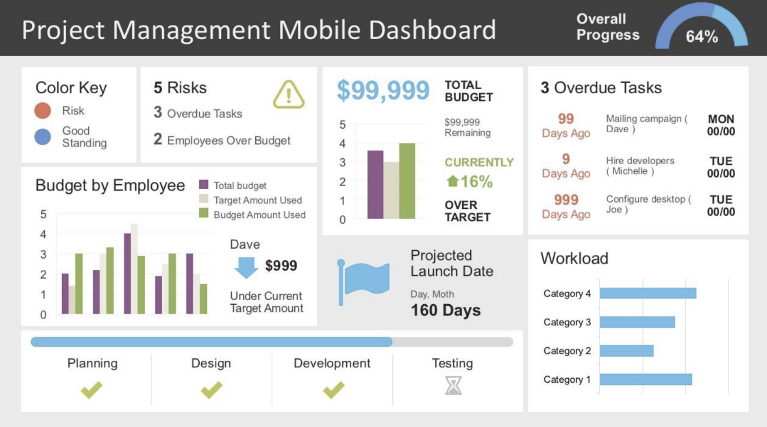
Status reporting
Monitoring &
Controlling Processes
Monitoring &
Controlling Processes
Integrated Planning
Project Start Up
Project Close
Managing Deployment
Monitor and measure progress, dashboards often used:
Communication tracker
Change control - Changes happen to project (internal, external, planned, un-planned, legal)
All changes have to be managed and controlled or the project will spin out of control

Slide 46
Project Close
Monitoring &
Controlling Processes
Integrated Planning
Project Start Up
Project Close
Project Close
Managing Deployment
As important as the start of the project
Team event to say “thank you” and for project feedback
Customer feedback
Closure of all financial documentation to support invoicing
Review project tracking, risk metric, etc.
Key aspect:
Learning - Lessons learnt

Slide 47
Let’s apply these stages…
How would you set up new restaurant?....
Project Start Up
Integrated Planning
Managing Deployment
Monitoring and Controlling Processes
Project Close
What shall be the concept of the restaurant?:
Objectives?
Who needs to be in the team?
What are the risks?
Who are the stakeholders? (people/organisations impacted by and who have an impact on the project)
What work is there to do?
Produce:
Gantt chart
Communication plan
Risk management
What needs to be managed as the project runs?
What shall we monitor as the restaurant is set up?
How can we close this project?

Slide 48
Possible example summary of the set-up new restaurant project
Set up new restaurant
Initiating Processes
Planning Processes
Executing Processes
Monitoring and Controlling Processes
Closing Processes
Concept: Healthy but delicious!
Deliver a healthy and tasty menu for target customers
Team structure:
Chef
Serving staff
Marketing
Etc.
Risks
Stakeholders
Potential customers
Food hygiene
Community
Funders
Planning
Etc.
WBS:
Design the menu
Kitchen design and layout
Restaurant design and layout
Purchasing of equipment and furniture
Installation and decoration
Training staff
Launch, publicity etc.
Gantt chart
Communication plan
Risk management
Direct/manage:
Ensure the kitchen is developed on time
Manage the design and setting up of restaurant
Work on the communications and marketing
Quality management
Recipe design and testing
Design of layout, furniture to met customers’ impression.
Team management
Communications
Stakeholders
Status/tracking
On time for launch
All processes working together
Project control
Scope, Cost, Schedule, Quality and Resources Control
Risk monitoring
Launch event – celebrate the work of the project team
Lessons learnt
Reporting
To funders
To planning

Slide 49
Summary
Different methodologies for project management.
Need some flexibility to incorporate change and respond
Define PMI’s (2017) 5 process groups: start up/initiating, planning, deployment/executing, monitoring and controlling and closing.
Begin to understand the management activities in each of these process groups (we will build further on this over the rest of the module)

Slide 50

BREAK
Take a 10 minute break, after the break…

Slide 51
Project Start Up
Setting Project Objectives
Stakeholder Management
Identifying Risks
Project Charter

Slide 52
Project Start Up
Monitoring &
Controlling Processes
Integrated Planning
Project Start Up
Project Close
Managing Deployment
Why/what is the project?
Project can be anything and any size
Internal or external customer based projects
Important in this stage…
Project specification and requirements
Better the specification, better the project outcome
Timing and deliverables
Identification of stakeholders
Overall project risk
Main output: Project Charter

Slide 53
Setting Project Objectives

Slide 54




Project specification: Objectives
The overall goal of the project should be clearly specified and recognised by all stakeholders involved in the project
An objective is:
a statement of results to be achieved
time based
with conditions specified
SPECIFIC
MEASURABLE
ACTIVITY and ACHIEVEMENT BASED
REALISTIC and RELEVANT
TIMED
Time
Quality
Cost
Scope

Slide 55
Consider the example of “Setting up a restaurant”
 Set up restaurant
Is this a SMART objective?
SPECIFIC
MEASURABLE
ACTIVITY and ACHIEVEMENT BASED
REALISTIC and RELEVANT
TIMED
Break the idea down into SMART objectives, for example:
Design a restaurant interior that conveys comfort and health by 18 June in line with a budget of £820,000
Develop marketing assets: logo, branding, tagline and visuals by
2 July
activity
specific
Design
restaurant interior that
conveys comfort and health
timed
18 June
budget of
measurable
£820,000
activity
specific
Develop
marketing assets: logo,
branding, tagline and visuals
timed
2 July
measurable
Notes:
Break the idea down into SMART objectives, for example:
Design a restaurant interior that conveys comfort and health by 18 June in line with a budget of £820,000
Design a kitchen that is ergonomic with an efficient layout to prepare healthy meals by 18 June in line with a budget of £450,000
Purchase all required kitchen and restaurant fixtures and fittings to begin construction and installation on 18 June, with a total budget of £1,270,000
Oversee the installation of the kitchen and restaurant to a high standard with a completion date of 30 July.
Conduct market research into the tastes and customer preferences in the area by 11 June.
Develop recipes that are delicious and designed with good nutrition using the recommended daily nutritional values by 2 July
Establish supplier relationships with key suppliers by 16 July
Test recipes with customers and consider feedback by 23 July
Final menu confirmed by 30 July
Develop marketing assets: logo, branding, tagline and visuals by 2 July
Prepare and market launch event by 9 July
Launch restaurant on 6th August

Slide 56

Activity: Write an objective for and analyse it.
Imagine you had been tasked with organising a “Welcome Back!” event for your course for after the summer vacation in Sept, 2024.
Write one objective for this Project
Post in the Chat
SPECIFIC
MEASURABLE
ACTIVITY and ACHIEVEMENT BASED
REALISTIC and RELEVANT
TIMED

Slide 57

Project Requirements
?
?
?
Definitions
Requirements – “A condition or capability that is required to be present in a product, service or result to satisfy a business need.”
PMI, 2021, pp. 247
Requirements Management Plan – “A component of the project or program management plan that describes how requirements will be analysed, documented and managed.
PMI, 2021, pp. 247
?
What?
?
?
?

Slide 58

Maylor (2017) links together stakeholders, requirements and measures (pp. 76)
Stakeholders
Item | Definition | Examples
Stakeholders | Any individual or group with an interest in the project outcome. | The project customers, the delivery team, the end beneficiaries of the project, anyone affected by the outcome, proponents and opponents of any change
Requirements | What each individual or group wants from the process or outcome | Defined requirements in the form of a specification or contract, implicit requirements (I want this project to be a good place to work), or legal/ethical/moral/commercial. Competitive requirements
Measures | The means by which it will be determined during and post project whether those requirements have been met | Level of compliance to the specification, customer satisfaction, level of return on investment, staff retention levels

Slide 59

How do we collect requirements?
Team &
Organisation
Collect data from project team and stakeholders:
Brainstorming
Interviews (with stakeholders)
Focus Groups (interactive discussion with key stakeholders and subject matter experts)
Questionnaires and surveys (pre-designed questions – can ask lots of people and get statistical data)
Benchmarking
Stakeholders

Slide 60
Requirements Traceability Matrix
A table that links requirements to their origin and traces them throughout the project lifecycle.
ID | Associate ID | Requirements Description | Business Needs, Opportunities, Goals, Objectives | Project Objectives | WBS Deliverables | Product Design | Product Development | Test Cases

Slide 61
Stakeholder Management

Slide 62
Stakeholder Management
Stakeholders
Stakeholders are people, groups or organisations that could impact or be impacted by the project
Identify stakeholder groups and analyse their power and interest

Slide 63
Stakeholder Groups and the Environment
Stakeholders
Rest of the world
Adapted from Figure 4.1 (Maylor, 2017, pp.78)
Core externals
Internal team
Constraints
Inputs
Out-comes
Project
Require-ments

Slide 64
Internal Stakeholders Project Team (adapted from Maylor, 2017, pp. 62)
PROGRAMME MANAGEMENT
 | PROJECT BOARD/PROJECT STEERING GROUP
USER REPRESENTATIVE | PROJECT SPONSOR | SUPPLIER REPRESENTATIVE
Senior User | Executive/Senior responsible Owner | Senior Supplier
TECHNICAL ADVISORY GROUP
CHANGE BOARD Delegated authority Technical capability
PROJECT MANAGER
PROJECT MANAGEMENT OFFICE Admin support Technical support Configuration management
TEAM MANAGER
TEAM MANAGER
TEAM MEMBERS
TEAM MEMBERS

Slide 65
Restaurant Example: Who are the stakeholders?
Rest of the world
Adapted from Figure 4.1 (Maylor, 2017, pp.78)
Core externals
Internal team

Slide 66
Restaurant Example: Stakeholder Groups
Rest of the world
Core externals
Food critics
Review websites
Competitors
Customers
Internal team
Marketing Consultant
Marketing intern
Procurement Administrator
Project Administrator
Building contractor
Electrical contractor
Heating contractor
Suppliers
Sponsor
Building control
Council planning
Local press
Social media outlets
Food Standards Agency
Existing restaurants in the group

Slide 67

Power/Interest Grid
Stakeholders
Key Player and Manage expectations
Highest priority for the project manager
Manage actively through active engagement
Keep satisfied
Moderate priority group
Need to keep this group sufficiently involved
High
Power
Stakeholder mapping
Monitor only
Lowest level for the project manager
Don’t overload them with communication
Keep informed
Moderate priority group
Objective is to sustain their interest and leverage when useful to the project
Low
Low
Interest
High

Slide 68
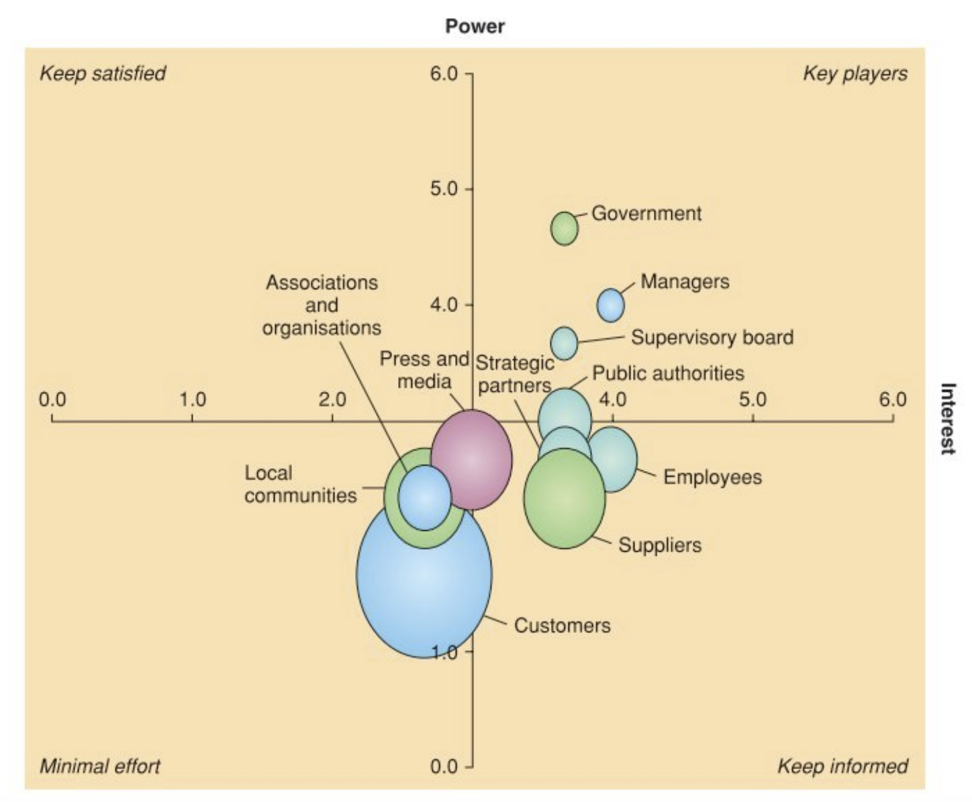
Example from Maylor (2017), pp. 92
European Transport Infrastructure

Slide 69
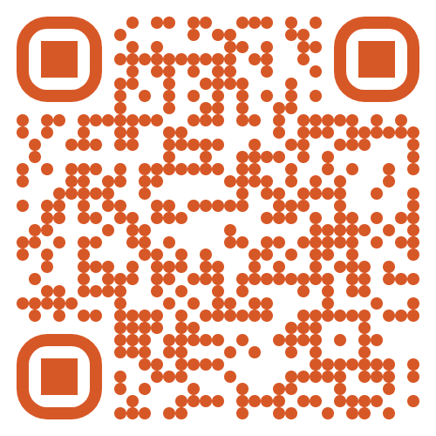
Group Activity- Analyse Stakeholders
Using the Restaurant Project
Identify:
Choose any 2 stakeholders?
Analyse:
For the 2 Chosen evaluate their:
Power – High/Low
Interest – High/Low
Mapping:
Post your Stakeholders identified onto the grid:
https://padlet.com/andresamuel2005/stakeholder
Notes:
HS2 tunnel protest will be first of many, says activist | Environmental activism | The Guardian

Slide 70
Overall Project Risk

Slide 71

Risks
Risk & Uncertainty
Adaptivity & Resilience
Definitions
Individual Project Risk – “is an uncertain event or condition that, if it occurs, has a positive or negative effect on one or more project objectives.” PMI, 2021, pp. 248
Overall Project Risk – “is the effect of uncertainty on the project as a whole, arising from all sources of uncertainty including individual risks, representing the exposure of stakeholders to the implications of variations in project outcome, both positive and negative.” PMI, 2017, pp. 435

Slide 72
Sources of Risk: Internal
Risk & Uncertainty
Adaptivity & Resilience
Maylor (2017, pp. 221) proposes these Key Project Risk Categories:
Health and safety
Legal
Also, you may want to consider: Resources
Time
Quality
Cost
Scope

Slide 73
External sources of risk: Stakeholders and PESTLE
Risk & Uncertainty
Adaptivity & Resilience
Consider risks from Stakeholders
Consider Environmental Risks (PESTLE)
Political context, Consideration of influence upon Government policies, taxation changes, foreign trade regulations, political risk in foreign markets, changes in trade blocks (EU).
Economic context, Consideration of influence upon business cycles, interest rates, personal disposable income, exchange rates, unemployment rates, GDP trends.
Socio-cultural factor context, Consideration of influence upon population changes, income distribution, lifestyle changes, consumerism, changes in culture and fashion.

Slide 74
External sources of risk: PESTLE continued
Risk & Uncertainty
Adaptivity & Resilience
Technological context, Consideration of influence upon new discoveries and technology developments, ICT innovations, rates of obsolescence, increased spending on R&D.
Environmental context, Consideration of influence upon environmental protection regulations, energy consumption, global warming, waste disposal and re-cycling.
Legal context, Consideration of influence upon competition laws, health and safety laws, employment laws, licensing laws, IPR laws.

Slide 75
Activity: Identifying Project Risk
Using:
Ikea’s expansion into India
What are/were the main risks?
Internal – cost, scope, quality and time, resources and legal
External – stakeholders and PESTLE
Discuss in your Breakout Rooms.
Post 1 Internal Risk and 1 External Risk
https://padlet.com/andresamuel2005/idrisks

Slide 76
Project Charter

Slide 77


Purpose of the Project Charter
Stewardship & Governance
Bring together Project Start Up into one document for project governance
Formal/informal
its background
the reasons why it is being carried out
the choice of options available for the project approach and outcome (it is important to include a ‘do nothing’ option to aid effective decision making)
the planned benefits the known risks
costs
the timescales envisaged
Owned by Project sponsor – Maintained by Project Manager

Slide 78
End Result: Project Charter (from PMI, 2017) also called a Project Initiation Document (PID)
Monitoring &
Controlling Processes
Integrated Planning
Project Start Up
Project Close
Managing Deployment
Contents of a Project Charter:
Project Purpose
Measurable project objectives and related success criteria
High-level requirements
High-level project description, boundaries and key deliverables
Overall project risk
Summary milestone schedule
Preapproved financial resources
Key stakeholder list
Project approval requirements (what constitutes success, who decides the project is successful, who signs off o the project
Project exit criteria (i.e.. What are the conditions to be met In order to close or to cancel the project or phase)
Assigned project management, responsibility, and authority level
Name and authority of the sponsor or other person(s) authorising the project charter
What?
Purpose, objectives, requirements
Risks
Timing and Resources
Stakeholders
Approval and authority

Slide 79
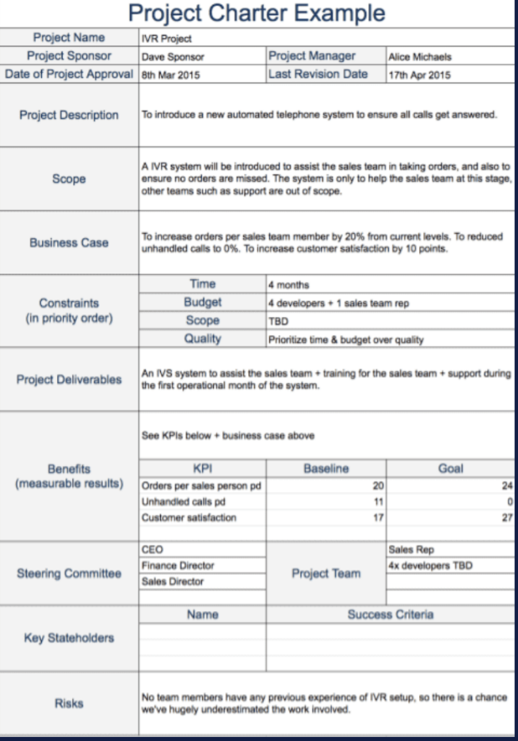
Example
Monitoring &
Controlling Processes
Integrated Planning
Project Start Up
Project Close
Managing Deployment
Different companies will have their own format for the document for you to follow

Slide 80
Example Project Charter (or PID), Restaurant example
Project Name | Delicious and Healthy
Project Sponsor | C. Rich
Date of Project Approval | 15 Jan
Project Description | To launch a new restaurant with a “Delicious and Healthy” theme, where customers feel they can go to relax and enjoy the food. Create a dining experience that takes away concerns about calorie intake, fat, excess sugar, salt, etc.
Scope and boundaries | “Delicious and Healthy” restaurant will need to be designed and implemented in terms of: menu; logo and branding and restaurant layout and feel. The customer service experience is out of scope as “Delicious and Healthy” customer service approach will mirror the parent company’s already defined processes. The recruitment of staff for the restaurant is outside of the project scope as this will be managed by the parent company. The kitchen layout and functionality is out of scope as this will be managed by the parent company.
Business Case | To diversify the parent company’s restaurant offering and increase sales, with a target of gaining return on investment in 2 years. To tap into a segment of the market that wants to have healthy options on the menu, but take this further to innovate and create nutrition and taste themed experience. Recent surveys indicate that 71% of diners say health should not be disregarded (Hospitality and Catering News, 2020) and that 68% try to eat healthy all or most of the time (Mintel, 2021)
Project Manager | Helen Benton
Last Revision Date | 15 Jan
Notes:
https://www.hospitalityandcateringnews.com/2020/01/new-restaurant-report-what-uk-consumers-want-from-eating-out/

Slide 81
Objectives and Deliverables
Project Objectives | Design a restaurant interior that conveys comfort and health by 18 June in line with a budget of £820,000 Purchase all required restaurant fixtures and fittings to begin construction and installation on 18 June, with a total budget of £1,270,000 Liase with parent group on kitchen installation and recruitment/training with a completion date of 30 July. Oversee the installation of the restaurant to a high standard with a completion date of 30 July. Conduct market research into the tastes and customer preferences in the area by 11 June. Develop recipes that are delicious and designed with good nutrition using the recommended daily nutritional values by 2 July Establish supplier relationships with key suppliers by 16 July Test recipes with customers and consider feedback by 23 July Final menu confirmed by 30 July Develop marketing assets: logo, branding, tagline and visuals by 2 July Prepare and market launch event by 9 July Launch restaurant on 6th August
Project Deliverables and milestones | Restaurant facility ready for launch in August with a healthy and comfortable layout and feel ready for 30 July Menu designed and tested, ready for 30 July Supply chain and key relationships established ready for 30 JUly Marketing assets developed by July Launch event organised for August

Slide 82
People, Stakeholders and Risks
Steering Committee | CEO Group Hospitality Director Group HR Director
Key Stakeholders | Project Sponsor: C Rich Project Team Contractors Consultants Existing restaurant franchises in the group
Key Risks | Procurement delays impacting the installation schedule Difficulties finding suppliers for key products Unable to develop food that is both healthy and delicious Customers do not like the menu etc
Project Team | Interior Designing Consultant Marketing Consultant Marketing intern Procurement Administrator Project Administrator Building contractor Electrical contractor Heating contractor
Competitors
Health and safety
Food standards agency
Local council
Customers

Slide 83
It doesn’t end there!
Scope and requirements can change as the project progresses
Stakeholder Management and Engagement continues in the project lifecycle.
Risks need to be analysed and managed through the project lifecycle

Slide 84
Summary of Start Up
Project Start Up is focused on determining what the project is about (and what it is not about)
Should include SMART (specific, measurable, activity, achievable, realistic and timely) Project Objectives.
Project Start Up has a focus on scope management by setting objectives and identifying the project requirements.
Stakeholders need to be managed as they can impact and are impacted by the project.
The internal team project, core externals and rest of the world are the main stakeholder groups.
Power and interest of each stakeholder needs to be considered.
Project risks can arise from internal and external sources.
There is more to do than identify stakeholders and risks – risk management and stakeholder engagement continues throughout the project lifecycle.
A Project Charter or PID brings together: project objectives, scope and requirements with key stakeholders and risks

Slide 85
Self-managed Study
Read Chapter 4 of Maylor (Kortext)
Have a go at the practice quiz
Continue working on your Part 1 - Reflection on Your Project Management Knowledge and Skills (25%)

Slide 86
References
Association for Project Management, 2020. APM Body of Knowledge, 7th ed. Princes Risborough: Association for Project Management
Axelos Prince2, 2017. Managing Successful Projects with PRINCE2® 6th ed, London: TSO (The Stationery Office)
BBC News, 2016. Demolition of Surrey 'hidden castle' almost complete, BBC [online] Available at: <https://www.bbc.co.uk/news/uk-england-surrey-36445848/> [Accessed 15 May 2021].
BBC News, 2021. M&S hits back at Aldi's Cuthbert the Caterpillar cake revival, BBC [online] Available at: <https://www.bbc.co.uk/news/business-56812445/> [Accessed 15 May 2021].
Maylor, H. 2017. Project Management 4th ed. Harlow: Pearson Education
Maylor, H. 2017. Project Management 4th ed. Harlow: Pearson Education
Project Management Institute, 2017. A Guide to the Project Management Body of Knowledge, PMBOK Guide 6th ed. Newton Square, Pennsylvania: Project Management Institute Inc.
Project Management Institute, 2021. A Guide to the Project Management Body of Knowledge, PMBOK Guide 7th ed. Newton Square, Pennsylvania: Project Management Institute Inc.
Royce, W., 1970. Managing the Development of Large Software Systems, [online] Proceedings of IEEE WESCON, 26 (August): 1–9 Available at: < http://www-scf.usc.edu/~csci201/lectures/Lecture11/royce1970.pdf> [Accessed 3 May 2021].

